Slide 1
Predicting Stock Prices
Piradon (Tien) Liengtiraphan

Slide 2
TOC
Overview
Trend analysis
Problems to solve
Data gathered
Project objective
Proposed solution
Market trends

Slide 3

Overview
This project aims to put an interesting spin on predictive quantitative finance, by using news headlines and the dates to which they are attributed to predict the stock prices. The crux of this project rests on how global and local events affect the actions of investors and the stability of the overall market, specifically the Dow Jones Industrial Average.

Slide 4
Problems to solve
Gather the date necessary to perform the desired task.
Including: News Headlines, Stock Prices
Converting the actual data points into vectors and pass them along to the Neural Network.
1
3
2
Formatting the data into the form that is readable and usable by the Neural Network
4
Running the Neural Network and determine the effectiveness of this hypothesis

Slide 5
Project objective
Predict the closing price of a certain stock using daily news headlines

Slide 6
Understanding the market

Slide 7

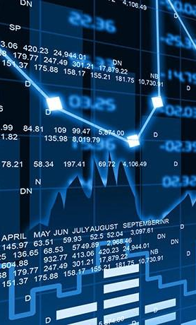
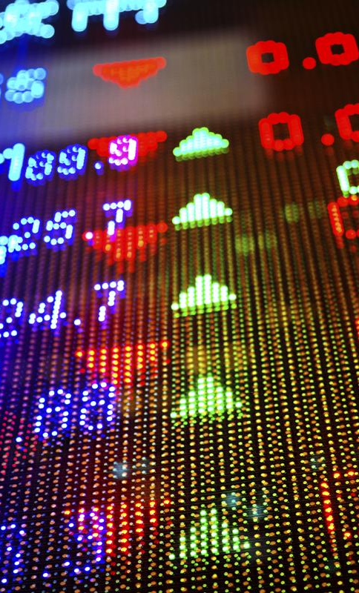
Direct Factors
01
Earnings are the profit a company makes, and in the long run no company can survive without them. Public companies are required to report their earnings four times a year (once each quarter).
Wall Street watches with rabid attention at these times, which are referred to as earnings seasons.
QUICK TIP
Try right clicking on a photo and using "Replace Image" to show your own photo.

Slide 8

Indirect Factors
02
Events happening around the world and at home can have an impact on a stock’s price if said news directly correlates to how a market might perform. I.E.: Natural Disaster, Market Crash, Presidential Election, etc.
There is much more nuance in this area, but said nuance can be a good indicator of investor behavior.

Slide 9
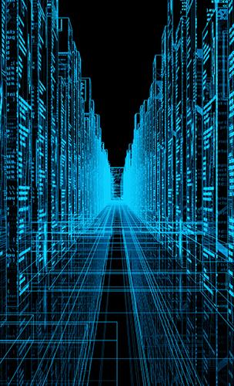


Data Gathered
Kaggle is a platform for predictive modelling and analytics competitions in which statisticians and data miners compete to produce the best models for predicting and describing the datasets uploaded by companies and users.
01 | all_stocks_5yr
02 | prices
03 | Combined_News_DJIA
04 | RedditNews

Slide 10
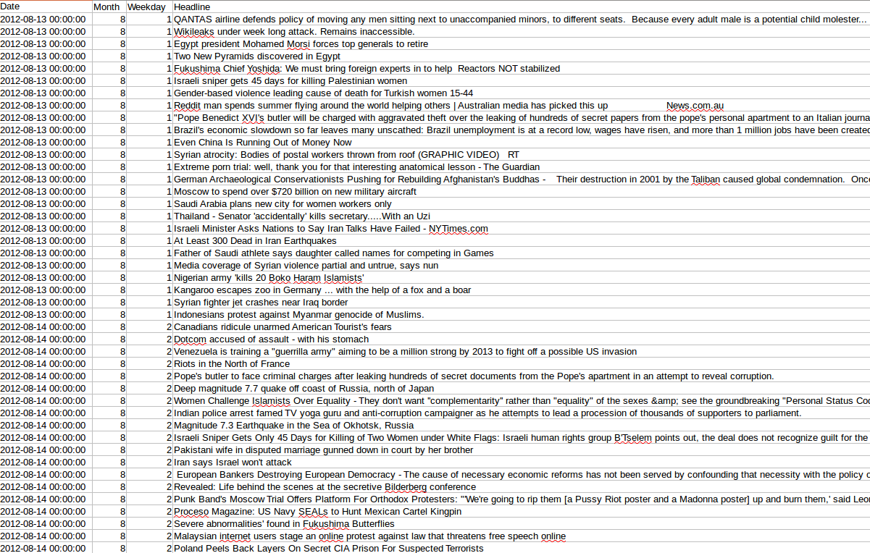

Slide 11
Proposed solution
Using a Convolutional Neural Network to take in news headlines as vectors to predict stock prices

Slide 12
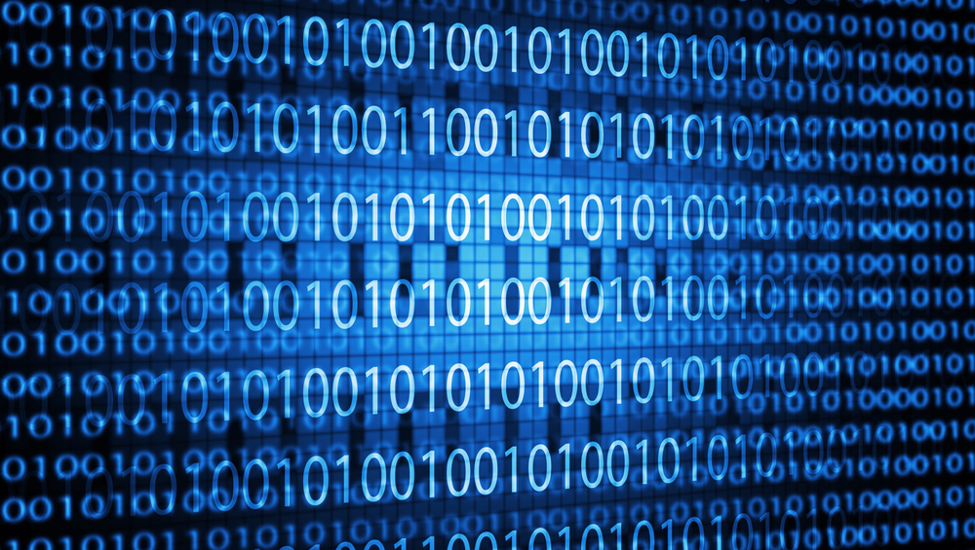
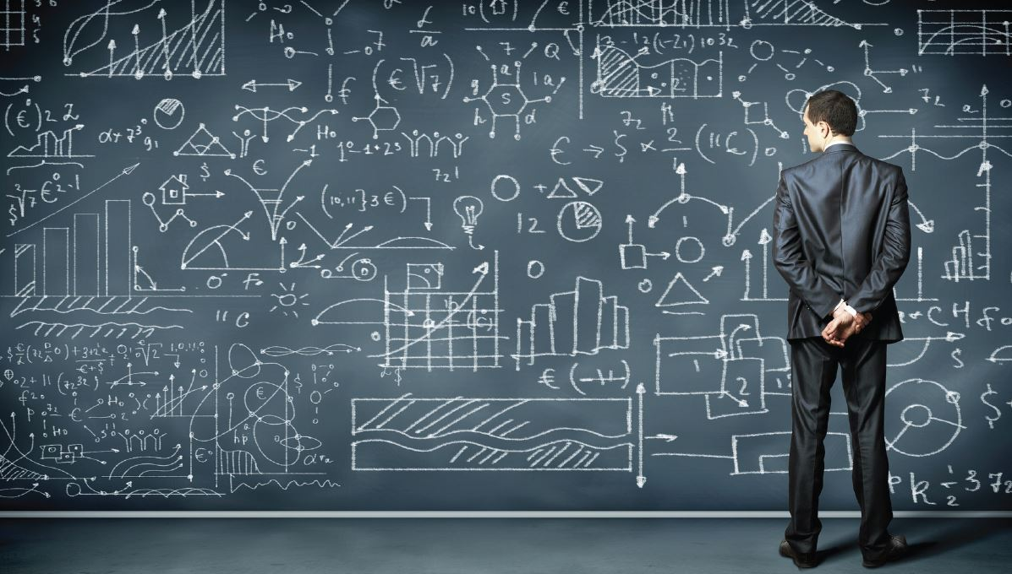
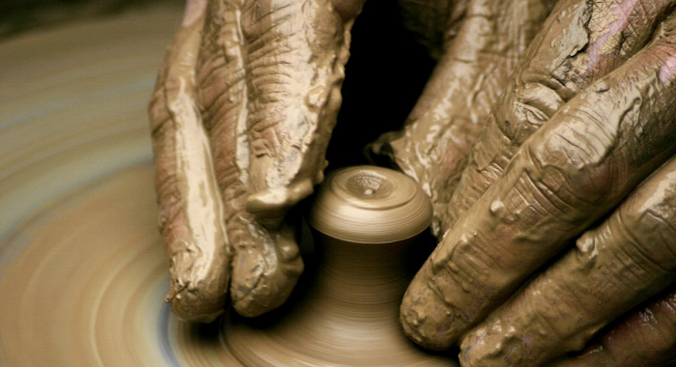
Process
Format Data
Gather Data
Sit Back and Run The CNN
01
03
Formatting the data into the form that is readable and usable by the Neural Network
02
Gather the date necessary to perform the desired task.
Including: News Headlines, Stock Prices
Running the Neural Network and determine the effectiveness of this hypothesis. Record the results

Slide 13
Thank you.

